Slide 1
To ARM and Beyond: Embedding seL4 in the Air Force
Kyle Tillotson Air Force Research Laboratory Information Directorate
DISTRIBUTION A. Approved for public release: distribution unlimited. Case Number 88ABW-2020-3625

Slide 2
Questions?
To submit questions please place them into the discussion board on the virtual hub page
You can use this area to continue the discussion after the presentation
I will be checking for new comments throughout the summit
DISTRIBUTION A. Approved for public release: distribution unlimited. Case Number 88ABW-2020-3625

Slide 3
Air Force Needs
DISTRIBUTION A. Approved for public release: distribution unlimited. Case Number 88ABW-2020-3625

Slide 4
Introduction
Based in Rome, NY
Mission
To explore, prototype, and demonstrate high-impact, game changing technologies that enable the Air Force and Nation to maintain its superior technical advantage
Cyber Science and Technology
Secure, composable, risk-based compute options
DISTRIBUTION A. Approved for public release: distribution unlimited. Case Number 88ABW-2020-3625

Slide 5
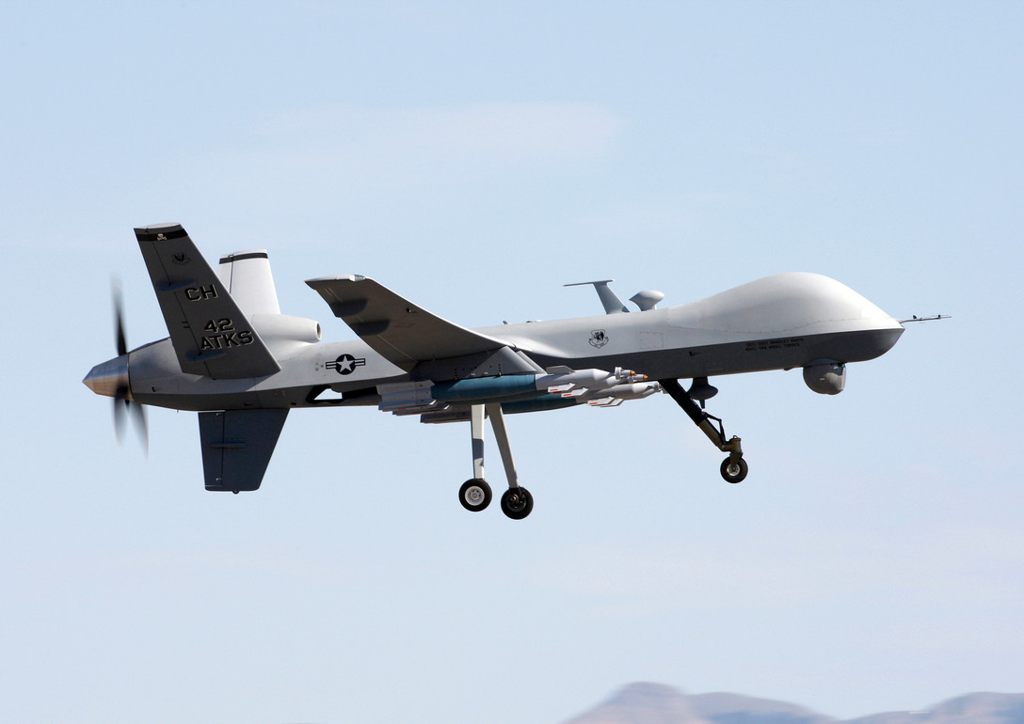
Air Force Risk Management
Can not rely on 9’s
Failure consequences
Cascading effects
Data classification
Very risk averse
Combined with aviation risk aversion
Conflicts with need to modernize
Cloud computing
Cost savings
Source: https://www.af.mil/News/Photos/igphoto/2000398487/
DISTRIBUTION A. Approved for public release: distribution unlimited. Case Number 88ABW-2020-3625

Slide 6
Air Force Needs
Mission focused
Do a thing, do it well
Do not give it up
B-52
Introduced 1955, last built in 1962
Still in service
How do you modernize a B-52?
Adding new capabilities with new vulnerabilities?
How will they react with existing platforms?
DISTRIBUTION A. Approved for public release: distribution unlimited. Case Number 88ABW-2020-3625

Slide 7
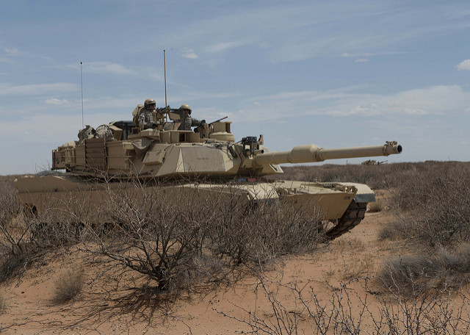
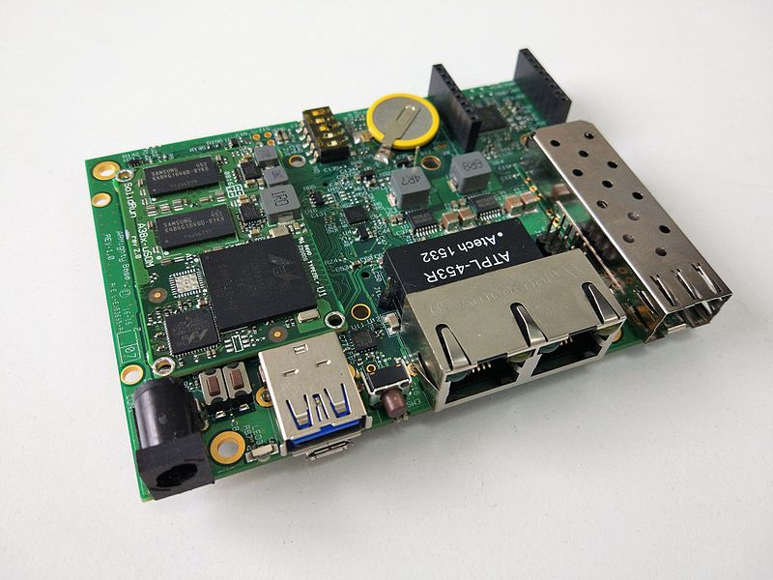
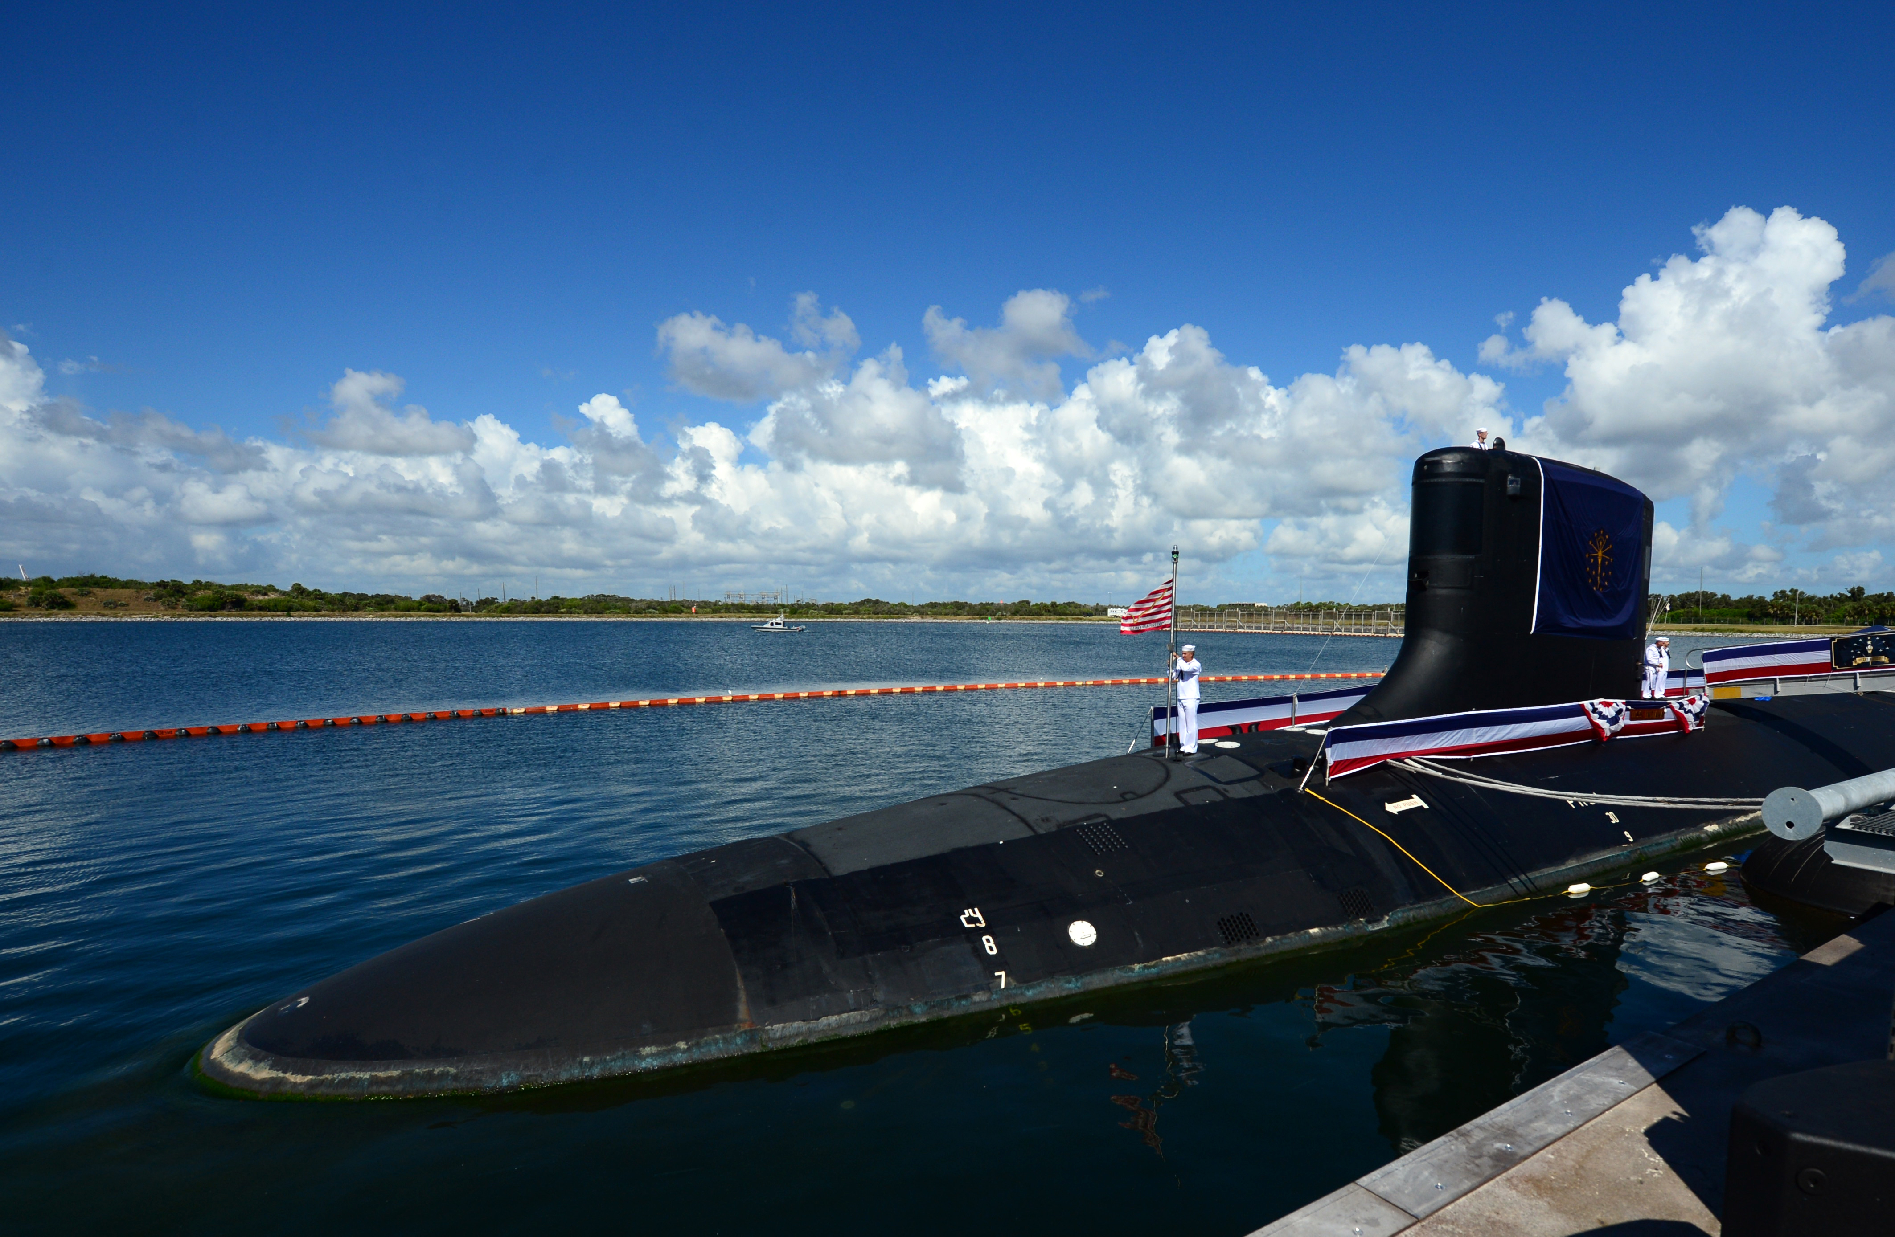
Air Force Challenges
How do you increase resilience in an Air Force platform?
Define “resilience”
Spotty access to source code
Diverse compute environments
Increasing use of ARM
Maintaining platform effectiveness
Demonstrating cyber benefits to command
Source: https://www.flickr.com/photos/grantwickes/13836611563
Source: https://www.flickr.com/photos/35703177@N00/8722357151//
Source: https://commons.wikimedia.org/wiki/File:ClearFog-base.jpg
Source: https://www.navy.mil/management/photodb/photos/180929-N-SU448-0062.JPG
DISTRIBUTION A. Approved for public release: distribution unlimited. Case Number 88ABW-2020-3625

Slide 8
seL4 Efforts
DISTRIBUTION A. Approved for public release: distribution unlimited. Case Number 88ABW-2020-3625

Slide 9
Current SW Environment
Tightly coupled
Lack of partitioning
Lack of interface control
Unsecured communications
How to make this better?
Formal verification is attractive to the AF
Focus on mission assurance
Isolate software components
Continue mission if component fails
Detect, Isolate, Recover
Applications
Operating System
Drivers
CPU
Memory
Peripherals
*Some systems implement commercial software separation kernels.
Significant cost in time, complexity, and funds to modify
DISTRIBUTION A. Approved for public release: distribution unlimited. Case Number 88ABW-2020-3625

Slide 10
Agile and Resilient Embedded Systems
Software isolation and introspection
seL4-native Virtual Machine Manager
Mission Essential Functions in separate VMs
Policy Enforcement Engine
Compare messages to mission parameters
Recovery service
HARDEN (MIT-LL)
Decompose mission into critical components
Determine vulnerabilities
DISTRIBUTION A. Approved for public release: distribution unlimited. Case Number 88ABW-2020-3625

Slide 11
Highly Assured and Defended Embedded Systems (HADES)
Build on ARES
Secure boot/recovery
Recover compromised MEFs
Provide root-of-trust for seL4
seL4 driver architecture
Micro-service driver framework
Starting point for driver development
RISC-V
Memory tagging (CHERI, DOVER)
HW/SW complementation
DISTRIBUTION A. Approved for public release: distribution unlimited. Case Number 88ABW-2020-3625

Slide 12
Future Work
DISTRIBUTION A. Approved for public release: distribution unlimited. Case Number 88ABW-2020-3625

Slide 13
Containerization
Challenging
seL4 is a microkernel
Is containerization even possible?
Demand from developers
Containers are the standard mode of distribution
AF is revising coding practices
Improving usability
Provide options
Pull between isolation and performance
DISTRIBUTION A. Approved for public release: distribution unlimited. Case Number 88ABW-2020-3625

Slide 14
Low-level Hardware Systems
Inverse problem for containerization
Custom architecture for specific purposes
Strict classification restrictions
Like utilities, looking to modernize
Interested in the formal verification aspects of seL4
Software execution assurance
How to best use seL4 in such an environment?
Local on each chip?
Higher-order controller?
DISTRIBUTION A. Approved for public release: distribution unlimited. Case Number 88ABW-2020-3625

Slide 15
seL4 and Manned Avionics
Focus has been on unmanned
How to use seL4 in a manned airframe?
Challenges
Large network
Proprietary hardware
Tight timing constraints
Possibilities
Network gateways
Expansion modules
DISTRIBUTION A. Approved for public release: distribution unlimited. Case Number 88ABW-2020-3625

Slide 16
Summary
AF needs make seL4 a good fit
ARES showed the AF that seL4-powered software works
Interesting applications of efforts
Improving usability to increase adoption
Take seL4 to ARM and beyond
DISTRIBUTION A. Approved for public release: distribution unlimited. Case Number 88ABW-2020-3625

Slide 17
Questions? kyle.tillotson@us.af.mil
DISTRIBUTION A. Approved for public release: distribution unlimited. Case Number 88ABW-2020-3625

