Slide 1


A Holistic Approach to Real Estate
Presented by:
Brian Schwatka,
Realtor & Transition Specialist
Keller Williams Bay Area Estates, Los Gatos
16780-A Lark Ave.
Los Gatos, Ca. 95032
Cell/Text: 408-499-9561

Slide 2





Brian Schwatka – Introduction
Realtor since 2004, located in Los Gatos, Ca.
Top 5% in the Nation and top 5% Worldwide
Work with homeowners of all ages, but I love seniors:
  Seniors Real Estate Specialist (SRES)
  Certified Seniors Advisor (CSA)
  Certified Probate Real Estate Specialist (CPRES)
  Transition Specialist
Why do I work with Retirees??

Slide 3



Why do I work with Retirees??
Transitions are MORE important at this age*
Too many people, too many choices
The internet is time consuming and frustrating
Predators take advantage of inexperience*
Homeowners are concerned and overwhelmed so they get “paralysis of analysis”.

Slide 4
How I Help Retirees
Give them clarity, certainty and confidence
Make educated decisions whether they are staying or going
Make things happen, don’t wait for things to happen
Focus on their house as their biggest investment
I am a resource, an advocate and someone they can trust
Reduce anxieties, stresses and fears
Save them time, money and frustration
Create a personalized plan for their future
No Expectations – No Strings Attached

Slide 5
Typical home selling
Homeowner decides they want to make a transition
Usually one or two reasons for their decision
They hire any Realtor
Realtor tells them how much it costs to sell
Realtor tells them their “net” proceeds
Homeowner makes the move
Homeowner then realizes that there was more to think about
Don’t make a move until all options are explored

Slide 6
Topics for Today’s Presentation
Different types of homeowners
A comprehensive “Holistic” way of looking at Real Estate
How to get a current snapshot of homeownership?
Imagining your vision of the future
Creating a Homeowner FlightPlan
When is the best time to make a transition?

Slide 7

Different Types of Homeowners
Want to stay
  Can you?
  Should you?
Somewhere in the middle
  Might want to go… (or you might need to go..)
  Where would I go?
  How would I go?
Want to go
  Current studies say 47% are ready to leave California

Slide 8
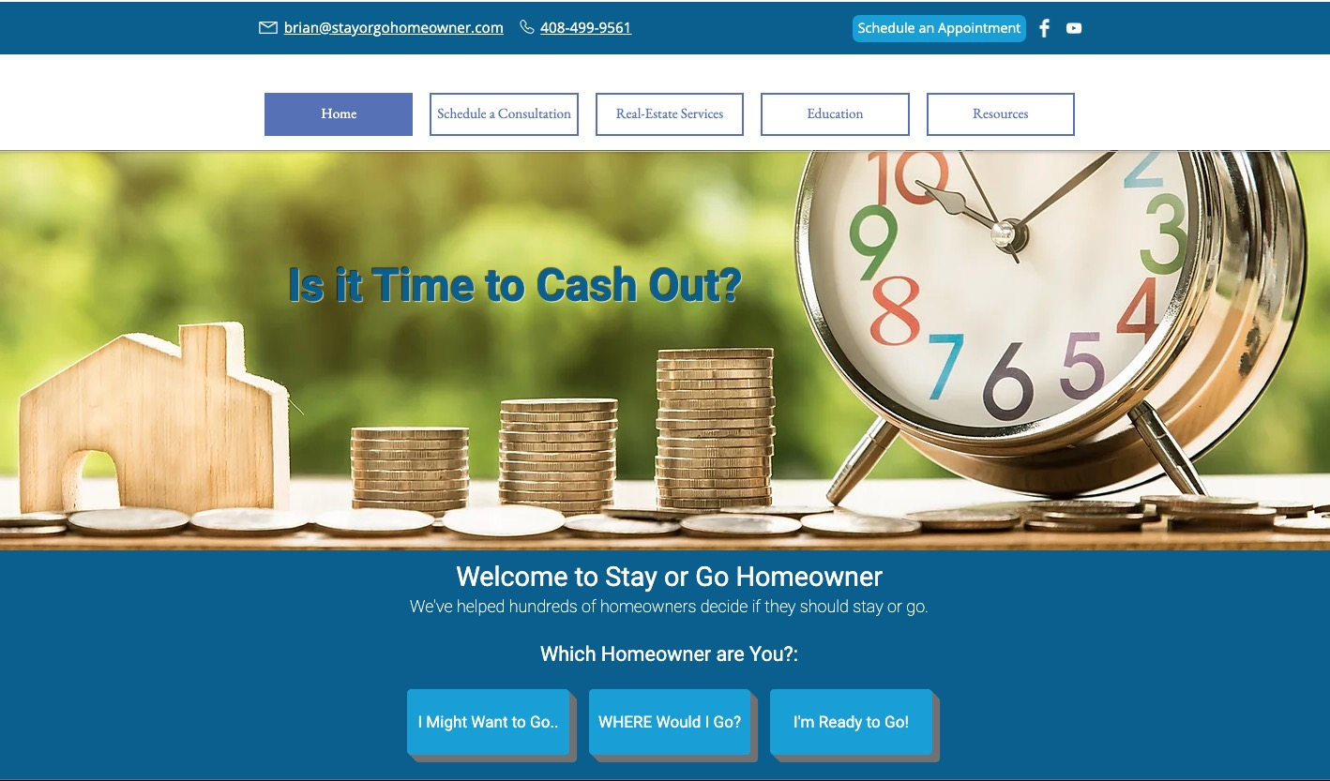

Slide 9
Holistic or “Whole-istic”
ho·lis·tic adjective
Definition of holistic
1: of or relating to holism
2: characterized by comprehension of the parts of something as intimately interconnected and explicable only by reference to the whole.

Slide 10
A Holistic Approach to Medicine
Physical
Environment
Emotional
Patient
Diet
Heredity

Slide 11
A Holistic Approach to Real Estate
Finances
Real Estate
Health
Seller
Trust & Estate
Personal

Slide 12
What is Stay Or Go Homeowner?
The ”Stay or Go Homeowner" system
helps homeowners decide if they should
stay in their homes or make a transition.
Evaluate
Educate
- Where do you stand?
- Where are you going?
- What you need to know to make educated decisions
Financial
Financial
Health
Health
Personal
Personal
Estate
Trust & Estate
Real Estate
Real Estate

Slide 13
Where do you stand in these areas?
Finances
Health
Personal
Trust/Estate
Real Estate
Cash Flow
Staying Healthy
Kids & Grandkids
Will and/or
Living Trust
Maintenance & Repairs
Net Worth
Social & Activities
Siblings & Relatives
Power of Attorney
Upgrades & Home Safety
Investments & Insurance
Emotional Well Being
Friends & Neighbors
Healthcare Directive
Age in Place
Mortgage(s)
Mobility & Incapacity
Support & Safety
Divorce or
2nd Marriage
Investment Properties
Capital Gains Taxes
Health Insurance
Vision of the Future
Holding Title Correctly
Downsizing
Inheritances Beneficiaries
Co-Owner Passing
Vicinity or Relocation
Avoiding Probate
Home Prep
& Sale
Financial Planning
In Home Care
Retirement Community
Trustees
Packing & Moving

Slide 14
Evaluating where we stand
Finances
Real Estate
Health
Seller
Trust & Estate
Personal

Slide 15
Evaluating where we stand

Slide 16
Evaluating where we stand

Slide 17
Evaluating where we stand

Slide 18
Example #1
High on Finance
Low on Trust & Estate
Lots of home equity
Positive cash flow
High net worth
Can pay for in-home care
Have a formal financial plan
No living trust in place
No power of attorney in place
No health care directive
Not holding title correctly
  Full or partial Step-Up in basis
  Probate
Finances
Trust & Estate

Slide 19
Example #2
High on Health
Low on Personal (social)
Drives
Cooks
Stays active
Stable physical condition
No local family or friends
Isolated
No activities with others
No educational classes
Health
Personal
Real Estate

Slide 20
Example #3
High on Real Estate
Low on Financial
Home is in decent condition
Home is safe to age-in-place
Home has a downstairs bed & bath
Neighborhood is safe and friendly
Low or no mortgage
Negative or neutral cash-flow
No funds to maintain the home
Can’t afford in-home care
Can’t access the equity in the home
Can’t qualify for a loan (retired)
Real Estate
Finances
Health

Slide 21
What is Stay Or Go Homeowner?
”Stay or Go Homeowner" is a system that
helps homeowners decide if they should
stay in their homes or make a transition.
Evaluate
Educate
- Where do you stand?
- Where are you going?
- What you need to know to make educated decisions
Financial
Financial
Health
Health
Personal
Personal
Estate
Trust & Estate
Real Estate
Real Estate

Slide 22

Where are we going?
The Joy of Strategy – A Business Plan for Life
A successful business requires a mission and a plan, and there's no more essential business than the business of your life.
With the perfect mix of soul and strategy, Allison Rimm’s The Joy of Strategy will get you motivated, organized and on your way to a fulfilling life.

Slide 23
Self Evaluation
What are some of my peak experiences?
When am I at my best?
When am I at my worst?
If I didn't have to worry about family, money, people, jobs, bills, houses, cars, health, and had ZERO responsibilities whatsoever, how would I spend my time?:

Slide 24
Postcard from the future (Homework)
Your perfect life in the present tense
Where are you?
What does it look like, sound and feel like?
What are you doing?
Who is with you?
What do you need so that every day is joyful
What must you avoid to be happy?
Pack your postcard with passion!
Make it authentic, grand, optimistic, wondrous

Slide 25



Evaluate
Educate
- Where do you stand?
- Where are you going?
- What you need to know to make educated decisions
4-6 hour Workshop
2 hour Workshop
1 hour Workshop
Holistic
Education
(Big Picture)
New Local Home
Retirement Living Community
Relocate out of the Area
Home Preparation
Homeowner Analysis
Buyer’s Agent
Community Introduction
Realtor Referral
FlightPlan
Engage/Execute
I might want to go
Where would I go?
I’m ready to go

Slide 26
The Big Picture
Finances
Health
Personal
Trust/Estate
Real Estate
Cash Flow
Staying Healthy
Kids & Grandkids
Will and/or
Living Trust
Maintenance & Repairs
Net Worth
Social & Activities
Siblings & Relatives
Power of Attorney
Upgrades & Home Safety
Investments & Insurance
Emotional Well Being
Friends & Neighbors
Healthcare Directive
Age in Place
Mortgage(s)
Mobility & Incapacity
Support & Safety
Divorce or
2nd Marriage
Investment Properties
Capital Gains Taxes
Health Insurance
Vision of the Future
Holding Title Correctly
Downsizing
Inheritances Beneficiaries
Co-Owner Passing
Vicinity or Relocation
Avoiding Probate
Home Prep
& Sale
Financial Planning
In Home Care
Retirement Community
Trustees
Packing & Moving

Slide 27
Educational Topics (4-6 hours)
Capital gains taxes
Holding title correctly
Co-owners passing away
Avoiding probate
Negative cash flow options
Reverse mortgages
Investment properties
Home safety services
In home care services
Retirement living options
Relocation areas
Retirement communities
Downsizing
Real Estate 101
Home preparation (ROI)
Sell it or rent it?
  Cash out or Cash flow?
Selling as-is
Creative buying options

Slide 28
Evaluate
Educate
- Where do you stand?
- Where are you going?
- What you need to know to make educated decisions
4-6 hour Workshop
2 hour Workshop
1 hour Workshop
Holistic
Education
(Big Picture)
New Local Home
Retirement Living Community
Relocate out of the Area
Home Preparation
Homeowner Analysis
Buyer’s Agent
Community Introduction
Realtor Referral
FlightPlan
Engage/Execute

Slide 29
Homeowner Analysis (1 hour)
Meet in person for questions and to discuss specifics:
  Who are the players and the family dynamics?
  History of homeownership and their estate (title)
  Home condition and compatibility
  Financial situation (positive, negative or neutral)
  Physical, social & emotional wellbeing
  Their vision of the future
Spell out multiple options
Give my non-biased, educated opinion(s)
Prepare for the financial planner
  CMA, capital gains, net proceeds, major debt, net worth

Slide 30
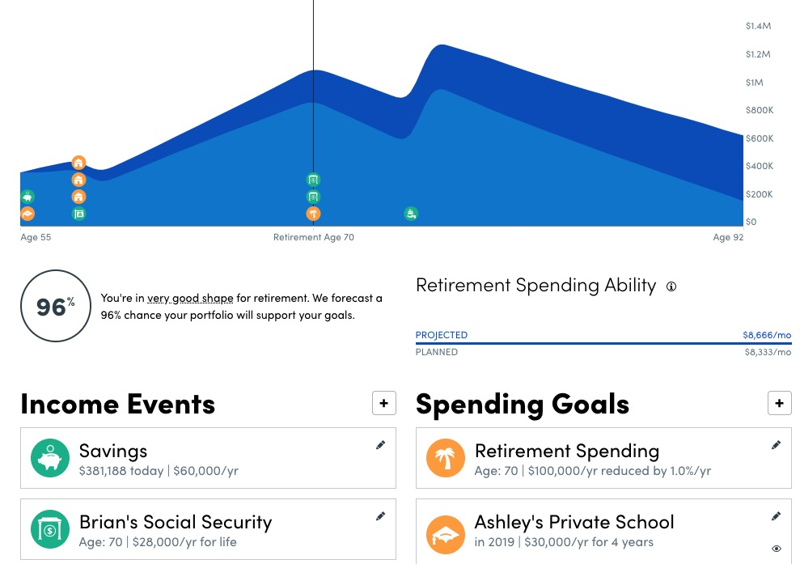
Analyzing The Financial Information

Slide 31
Evaluate
Educate
- Where do you stand?
- Where are you going?
- What you need to know to make educated decisions
4-6 hour Workshop
2 hour Workshop
1 hour Workshop
Holistic
Education
(Big Picture)
New Local Home
Retirement Living Community
Relocate out of the Area
Home Preparation
Homeowner Analysis
Buyer’s Agent
Community Introduction
Realtor Referral
FlightPlan
Engage/Execute

Slide 32
Stay Or Go Where?
New local homes, what do you get for the money?
Retirement Living Communities
  Active independent communities like the villages
  Continuing Care Retirement Communities CCRC’s
    Myths of Retirement Living: costs, rules, and perceptions
Relocating out of the area taking into account: Weather, health care, transportation, culture, costs
New Local Home
Retirement Living Community
Relocate out of the Area

Slide 33
Evaluate
Educate
- Where do you stand?
- Where are you going?
- What you need to know to make educated decisions
4-6 hour Workshop
2 hour Workshop
1 hour Workshop
Holistic
Education
(Big Picture)
New Local Home
Retirement Living Community
Relocate out of the Area
Home Preparation
Homeowner Analysis
Buyer’s Agent
Community Introduction
Realtor Referral
FlightPlan
Engage/Execute

Slide 34
Creating the FlightPlan
Decide on a destination (The next home)
  What did the financial planner say? (How much fuel?)
  Smaller house, retirement community or re-location
  Buying first or selling first?
Choose a co-pilot (The Realtor/Transition Specialist)
Condition of the plane (The current house)
  Inspect and disclose information on the house
  Goal is to sell the home “As-Is”
Prepare for lift off (Home preparation)
In-flight expectations and emergency plans (The transaction)
The arrival at the desired destination, (Postcard from the future).

Slide 35
When is the best time to depart?
Before your health declines?
Before a co-owner passes?
Before you go crazy from boredom?
When you’re tired of cooking and cleaning?
Before you call the handyman? AGAIN...

Slide 36
The Perfect Scenario: Buy Low / Sell High
Best Time
to Sell
Thrill
Anxiety
Panic
Hope
Best Time
to Buy

Slide 37
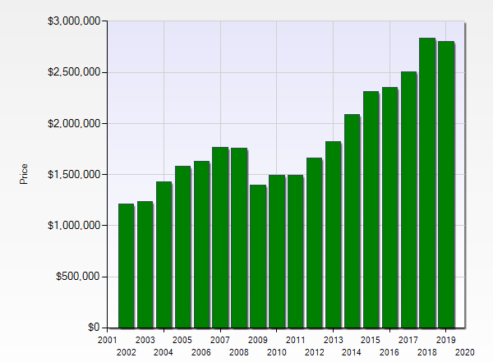
Q: When is the right time to make a transition?
A: When your investment is at it’s highest point
Los Gatos/Saratoga
$1.5Mil
in 17 years
or
$88,000/yr.
Markets change about every 10 years

Slide 38
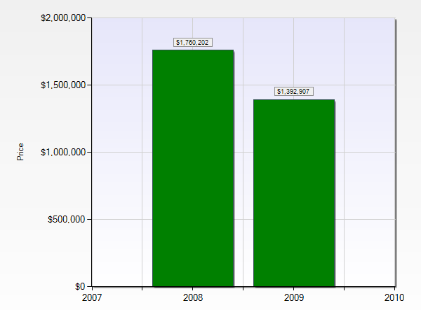
The Most Expensive Cost of Staying
Los Gatos/Saratoga
2019 Average Sales Price was $2.8Mil
10%= $280K
20%= $560K
2008
2009
In one year
Price drop of $367,000 or -20%

Slide 39
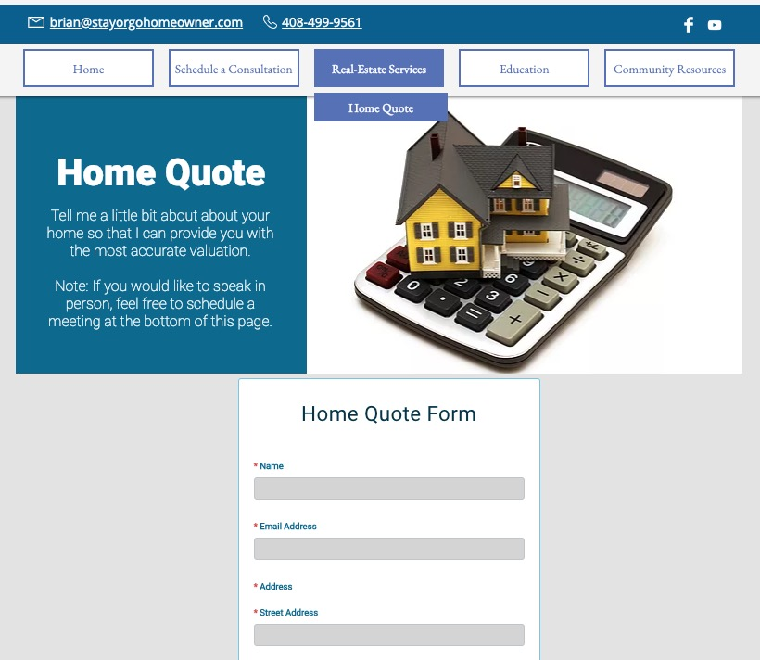
StayOrGoHomeowner.com
StayOrGoHomeowner.com
StayOrGoHomeowner.com
StayOrGoHomeowner.com/home-quote

Slide 40
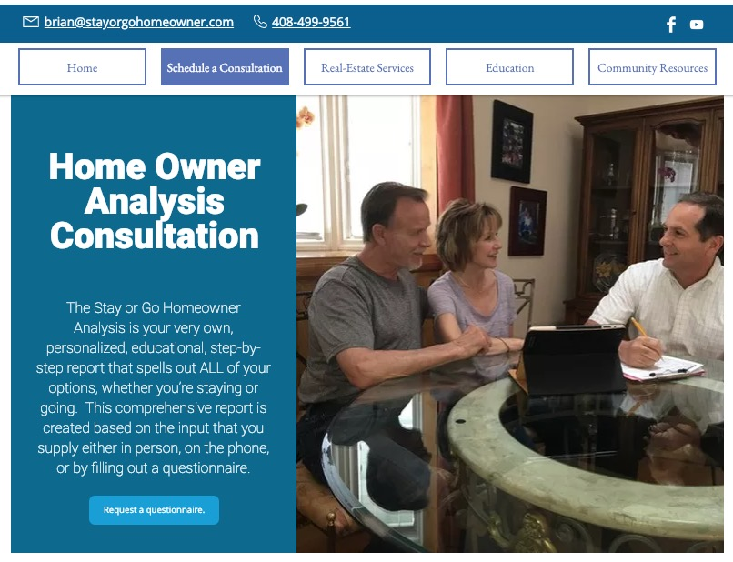
StayOrGoHomeowner.com
StayOrGoHomeowner.com
www.StayOrGoHomeowner.com

Slide 41
In a nutshell
This is a huge decision – could be your last move..
Don’t outlive your money!
Create a vision of your future – Work backwards from that
Educate yourself - Gain clarity, certainty and confidence
Explore ALL of your options
  Be a Holistic Homeowner - Everything matters
I’m behind you 150% whether you stay or go

Slide 42

A Holistic Approach to Real Estate
Presented by:
Brian Schwatka,
Realtor & Transition Specialist
Keller Williams Bay Area Estates, Los Gatos
16780-A Lark Ave.
Los Gatos, Ca. 95032
Cell/Text: 408-499-9561

