Slide 1
Cobbs Mill Inn Property
Draft Business Plan Presentation

Slide 2
Agenda
Kleber and Sandra Siguenza are pleased to discuss with you the plan and vision we see for Cobbs Mill Inn property. This draft business plan will discuss the following –
Introduction of the Prospective Owners
Business Opportunity
Market – Customers & Competitors
Why Us?

Slide 3
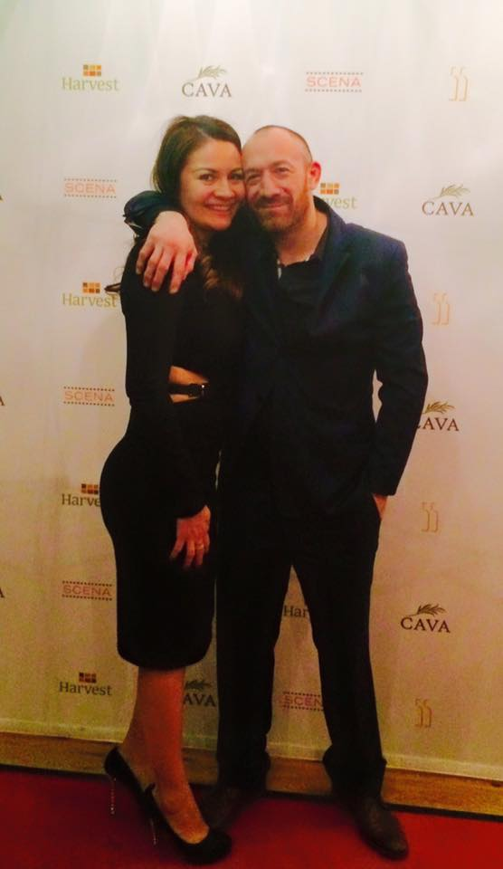
Prospective Owners of the Property
Kleber and Sandra Siguenza:
Have over 25+ years in restaurant management experience.
Aside from this investment, the Siguenza’s have 9 restaurants operating under JS Restaurant Group. JS Restaurant Group opened their first restaurant located in New Canaan, Cava Wine Bar Restaurant, in 2004.
All restaurants are family owned and operated.
All restaurants are highly reputable and located in Connecticut (primarily Fairfield County). Our Harvest Restaurant located in Greenwich received an “Excellent” rating from the New York Times, the highest possible rating given to an establishment.
Out of the 9 restaurants currently operating, two are located on Yale properties in New Haven and partner closely with Yale University (both faculty and students).
Sandra (Left) and Kleber Siguenza (Right)

Slide 4
Business Opportunity - Problem
Problems with the Town of Weston:
The problem with The Town of Weston is that the community is in desperate need of a warm and friendly place for friends and family to gather with excellent food. The problems we note are –
No venues to hold events in town. Examples include concerts, weddings, etc.
No establishments providing accommodations for travelers and/or visiting families.
No more than 1 restaurant in the Town.
No luxury restaurants.
No dining establishments that serve good quality food for low budgets/incomes. Examples include students, local workers, etc.
To get food, locals (aside from the 1 restaurant in Weston) typically order delivery/pick-up from out of Town.
There is no grocery store in Weston now that Peter’s Market closed.

Slide 5
Business Opportunity - Solution
Solutions to the issues facing the Town of Weston:
The Siguenza’s have various solutions to the issues facing the Town of Weston, which are:
An event and wedding venue located on the first level, main floor of the property. The décor and atmosphere will be significantly updated and modernized, while maintaining the integrity of the Inn.
To re-create a casual lunch/dinner facility where the coffee shop is currently located. We will be requesting permission for a kitchen and hood system for baking goods.
Use of the current Inn rooms (located on the second floor) for overnight wedding guests.
The downstairs bar and restaurant area to be updated and refurbished/restored, while still maintaining the history and beauty of the property. The restaurant will continue to act as an upscale restaurant and bar.
To refresh the available outdoor space and revitalize its permitted usage. This area may be used for rehearsal dinners and small gatherings such as baby showers, team dinners and family events.
We want to keep the Cobbs Mill Inn as a part of history for the Town of Weston and as a result, seek to restore the building. This is a very historical building and want to remind the community of it as the establishment also hosted President’s of the United States and other important figures. The building itself is among the oldest structures in the country, predating the Revolutionary War.
There are not many events for the community. With this property, we hope to partner with the Town in order to create events.

Slide 6
Market – Customers & Competition
The target customers we see for this investment are the following:
Local Weston Community - Students, families, local town workers (i.e., police, fire fighters, town hall workers, teachers/faculty), and laborers (i.e., construction workers).
Surrounding Cities - We seek to attract residents from various cities nearby Weston such as Wilton, New Canaan, and Westport.
Commuters – Individuals commuting to work.
Our competitors in the area will be the following:
Competition in Town – There is only 1 restaurant located in Weston. The only competition are the restaurants located in the cities that surround Weston.
Competition Outside of Town – There are several cities to order from nearby Weston, however, deliveries take time to arrive.

Slide 7
Why Us?
The Town of Weston should feel comfortable with the Siguenza’s owning the Cobbs Mill Inn property, due to the following reasons:
Experience – Professional and highly trained management, with more than 25+ years of restaurant management experience. The Siguenza’s operate 9 other restaurants, which are still open and located all over Connecticut. Kleber is also a pastry chef who graduated form the Culinary Institute of New York.
We are local Westoner’s Too! - We want to create a wonderful community for families, especially for our own family as we have two little boys who attend Weston Public Schools.
Create More Jobs and Stimulate the Local Weston Economy
Community - Create a stronger community presence filled with events. For example, using the outdoor space for potential events for the Town of Weston.
Place Locally To Stay for Visitors – We hope to have the inn rooms open again for overnight wedding guests and hope to reopen the only Inn within Town.
Historical Importance to the Town of Weston - We seek to educate the local community of the historical importance of the Cobbs Mill Inn property and will preserve/restore the property.

