Slide 1


Selling seL4 to Commercial Sectors -- Opportunities and Challenges
Xinming (Simon) Ou
Raj Rajagopalan

Slide 2

A Tale of Two Efforts
Use seL4 to improve the security of building automation systems (BAS)
  Built physical prototypes using both seL4 and Linux and demonstrated how attacks fare on each
Transition the technology to a major BAS vendor
  Built multiple proof of concepts for the company
  Convinced business units that seL4 is the preferred technology to use for future products
Efforts funded by the DHS CPSSEC program

Slide 3
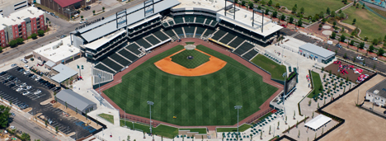
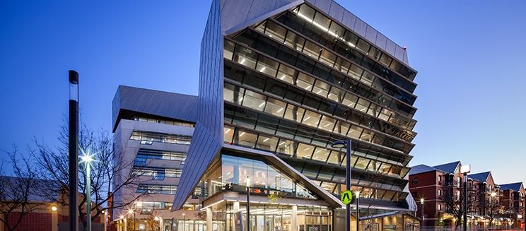
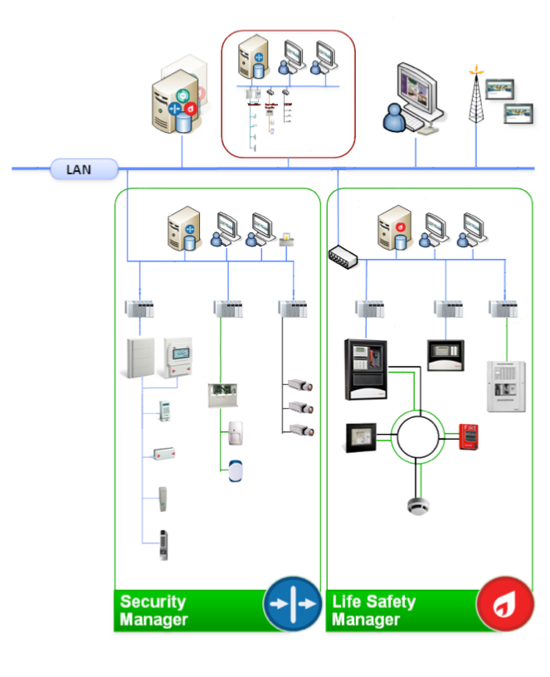
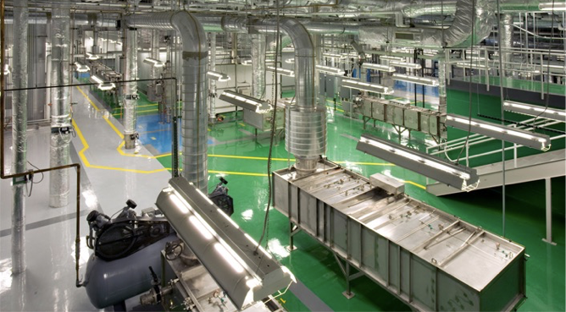
Buildings are critical cyber infrastructure
Building automation system (BAS) inter-connects multiple types of cyber physical systems (CPS)
Computerized controls moving towards “smart” like the rest of the world

Slide 4









Internet
Enterprise IP Network
Building Controllers
Field Devices
Buildings are already on the Internet. Achieving security through network isolation is no longer possible.
Stepping stone for launching attacks on other CPSes connected to BAS
Most value and new attack surfaces in “intelligent” applications
Core Customer Need:
Protect Buildings from Cyber Threats

Slide 5
Solving the Problem:
Three Questions
What is the problem?
How much of the problem did you solve?
What is the cost vs benefit tradeoff?

Slide 6
What is the problem?
From the security perspective
  Standard software is not trustworthy.
From the operations perspective
  Consequence of compromise is unpredictable
From the engineering perspective
  Patches are expensive in time and effort
From the governance perspective
  Liability is high
From the marketing perspective
  ? (We are missing this key piece)

Slide 7
How We Approached Tech Transition to a Major BAS Vendor
Tech transition happens with people transition
  The primary PhD student spent three internships at the company
  Engage business early on
Be flexible in your solution
  Companies have legacy code base developed for existing platforms
  It is cost-prohibitive to replace architecture overnight
  It is unrealistic to expect businesses to build applications from scratch in favor of security

Slide 8
This is what we told them in summer 2017

Slide 9

What a generic IoT Device looks like:
Proprietary IoT Solution
application vulnerabilities
malwares
IoT devices are more vulnerable to cyber attacks because they lack traditional protections such as firewalls/anti-virus.
Big attack surface – see figure
No internal separation e.g. a compromised application can access key data and make outbound network connections
“Breach and patch” cycle increases operational costs
Application
Application
Third-party Application
Libraries
Runtime Libraries
runtime vulnerabilities
kernel rootkit
Virtual File System
Process Control
Network Stack
Device Drivers
driver
vulnerabilities
OS (e.g. Linux, Android, Windows)
Hardware (e.g. ARM Processor)
firmware rootkit
Hardware (e.g. ARM Processor)

Slide 10
The Cost-Security Tradeoffs
Security is currently an all-or-nothing proposition because a vulnerability anywhere can be devastating.
Securing everything on the device is costly.
  Fixing security bugs in legacy and third-party software is cost-prohibitive.
  Every time new software is added to the system the risk goes up again. But we cannot eliminate or postpone software changes.
What we need is a low-cost security solution that secures critical elements and leaves the rest of the system mostly unchanged.
Security controls must be transparent, tamper-proof, and non-bypassed.
Evolve as the hardware and software in the product change

Slide 11
How to Protect Ourselves from the Threats?
Proprietary IoT Solution
Create a “secure space” to store security-sensitive info and processes (e.g. key data, encryption) that cannot be accessed by any adversary
Protect our applications and libraries from unauthorized access
Compatible with current hardware & software stack
Works well with or without special hardware support
Secure space should be “future-proof” (i.e. no bugs or patches in the future)
Application
?
Application
Third-party Application
Libraries
?
Runtime Libraries
?
Virtual File System
Process Control
Network Stack
?
Device Drivers
OS (e.g. Linux, Android, Windows)
Hardware (e.g. ARM Processor)

Slide 12
Proposed Solution
Uses secure microkernel as a microvisor
Sensitive applications run natively in an isolated secure partition, provide all security-related functionality
Traditional OS+s/w stack runs in a virtualized environment; applications do not see anything different from legacy
Applications request sensitive services from secure partitions though microkernel IPC using modified libraries
Microkernel audits/mediates all interactions through pre-defined policies
Isolated Secure partition
Application
Application
Third-party Application
Libraries
Runtime Libraries
Virtual File System
Process Control
Network Stack
Secure Storage
Sensitive App
Device Drivers
OS (e.g. Linux, Android, Windows)
Libraries
Microkernel
Policy
Hardware (e.g. ARM Processor with MMU)

Slide 13
Current/Standard Linux Architecture
Proposed Secure Controller Architecture
encrypt/decrypt request
encrypt/decrypt request
crypto Client App
crypto Client App
Anther Linux App
crypto Server App
L4Linux
crypto Server App
Native App
Libraries
User Mode
module
Linux
Kernel Mode
Support Libraries
File System
Init Process
L4Re
Socket
Root Task
Root Pager
User Mode
Drivers
Modules
L4 microkernel
Kernel Mode
Hardware with MMU
Hardware with MMU
Crypto key stores file system
Misconfiguration or breach will cause the key accessible by all applications
Any bug or breach threatens the system security and leads to information leak
Crypto key stored in isolated partition
Privileges are explicitly specified through distribution of capability and delegated from the hardware Root-of-Trust based on MMU.
Even if the whole Linux partition is compromised, key will never leak at runtime.
The Goal of this demo: show the private key will not be leaked through cyber attack

Slide 14
Moving Forward
Current design guarantees the crypto key will not be leaked through cyber attack
More security critical applications can be gradually moved to secure partition
Secure storage can be implemented in secure partition
Secure boot can be incorporated
With more powerful hardware we can run standard Linux distribution using hardware assisted virtualization
TPM can be applied to further protect the key from physical attack
The microkernel can run in Secure World in ARM TrustZone
System security can incrementally evolve
Linux App
crypto Server App
crypto Client App
L4Linux
Ethernet
Driver
Secure Storage
module
Support Libraries
Init Process
Root Task
Root Pager
User Mode
L4 microkernel
Kernel Mode
Hardware with MMU

Slide 15

Future: Working with TPM
crypto Client App
crypto Server App
Other App
crypto Client App
Anther Linux App
crypto Server App
L4Linux
Secure Storage
TPM Driver
Libraries
User Mode
module
Linux
Kernel Mode
Support Libraries
File System
Init Process
Root Task
TPM Driver
Modules
Root Pager
User Mode
L4 microkernel
Kernel Mode
TPM
Hardware with MMU
Hardware with MMU
TPM
Key stores in TPM
Compromise app with root privilege can abuse TPM driver
TPM coprocessor is slow (1s for RSA calculation)
TPM stores the key nothing else
Have a secure anchor for storing keys but lack of chain of trust
Root key stores in TPM
Derived keys can store in secure storage that sealed by root key in TPM
Enables various secure features: full disk encryption, remote attestation, etc.
Chain of trust established through trusted kernel, capability secure model

Slide 16
What Happened Later that Summer
Daniel (the PhD student) successfully implemented the PoC of the secure execution environment.
The company engineer used the wrapper function written by Daniel to access the secure partition; everything worked like before.
The business team then asked us what it will take to make it run on seL4, instead of L4Re.
  Because they believe the formal verification of seL4 can make the business case for adoption

Slide 17
What Lessons We Learned through that Experience
Security solution must be transparent (painless)
  But, argument for cost can be made
Adoption is a gradual process
  Timing has to be right (element of luck)
Value of a formally verified system can be accepted by business
  We initially proposed using seL4 but met resistance due to hardware compatibility and support issues
  When business became really serious about our work, they wanted seL4

Slide 18
Then Came Spring 2018

Slide 19
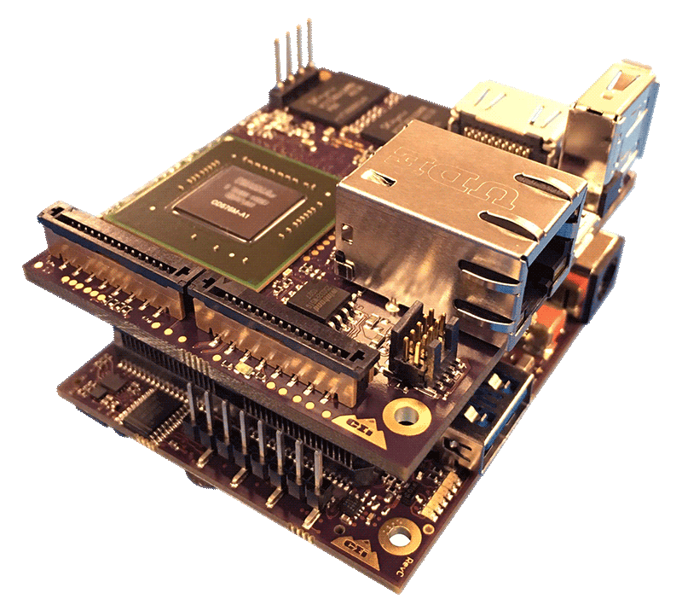
Using seL4 as a Microvisor
seL4
  First formally verified microkernel in the world
    end-to-end proof of implementation correctness
  high performance
  Can be built as micro-supervisor with hardware assisted virtualization
    ARM HYP Extension
    X86 VT-x
Our prototype
  NVIDIA Jetson Tegra K1-SOM (ARM Cortex-A15) with virtualization extension
  CPU virtualization – new “Hyp” privilege mode more privilege than “SVC” mode
  Memory virtualization – intermediate physical address
  I/O virtualization – virtual interrupt controller
Linux Apps
Standard
Linux
module
Com
Server
Native App
VMM
CapDL-Loader
seL4 microkernel
Privilege Mode
ARM Cortex-A15

Slide 20
Current prototype: Secure Execution Environment
Linux Apps
Fully virtualized partition runs unmodified standard Linux
Microvisor partitions memory and storage
“Guest” Linux can only see its own partition
Communication with “Native App” through “Com Server”
Secure Boot
  VMM verifies guest Linux image
  If Linux is being replaced VMM can stop the booting and start recovery process
  E.g. download Linux image from trusted server; report remote admin, etc.
Standard
Linux
module
Recovery App
verified
failed
Com
Server
Native App
VMM
CapDL-Loader
seL4 microvisor
Privilege Mode
ARM Cortex-A15

Slide 21
Secure Boot
Signature
Linux kernel
VMM loads sig file, public key and verified
Booting Process
  Tegra boot ROM
  U-boot
  ELFloader
  seL4 kernel
  CapDL-loader
  VMM
  Guest Linux
Can be integrated with U-boot verified boot
VMM
Comm Server
Native App
capDL unpacks apps and assigns caps
CapDL-loader
seL4
ELFloader unpack seL4 kernel and load it into correct memory position
Jump seL4 entry
Check hash/signature
(Optional)
ELFloader unpack capDL-loader and load it into correct memory position
ELFLoader
Verified Boot verifies binary and configuration signature before jump to the entry
U-boot
Vendor supports tools
Fuse public key in ROM
Only signed U-Boot can run
bootROM

Slide 22
Future: Execution Environment Isolation
Multiple (possibly different) instances of Linux with different privileges can run as guest OSes
Apps reuse Linux execution environment (drivers, third-party, etc) without porting/rewriting
The formally verified seL4 provides isolation and mediated communication
App
Crypto Server
Network Stack
Linux
Linux
Linux
VMM
VMM
VMM
CapDL-Loader
seL4 microkernel
Privilege Mode
ARM Cortex-A15

Slide 23
Comparison: TrustZone (ARM Security Extension) vs. ARM Virtualization extension
Virtualization extension extends TrustZone
TrustZone can only have one normal world rich OS
Virtualization Extension allows multiple guest OSes running in isolated environment
Virtualization Extension allows dynamic allocation of hardware resources
Virtualization has better performance, and better real-time support
Maximize the benefit for using formally verified microkernel

Slide 24
Strengths and weaknesses of the approach
(+)
Strong isolation enables an incremental strategy to focus on specific functions (first) while allowing the rest of the system to continue to be built
  Crypto/security and networking functions can be addressed first.
  Safety or special functions like secret data handlers can be isolated to safeguard high risk elements.
Even if the attacker gets root on the legacy partition he can only get access to provisioned data.
We can remotely reboot or update individual partitions without affecting other partitions
Formal verification guarantee and minimal use of sel4 means that almost surely there are no defects in the hypervisor – no possibility of bypass and no future patches.
Hardware supported virtualization means almost no performance hit.
Virtualization architecture enables us to run drivers without modification.
Future PSIRT incidents are likely to be of lower criticality.
Different function categories can be put on different development cycles

Slide 25
Strengths and weaknesses of the approach
(-)
Does not solve the problem of bad software, merely eliminates much of the interactions
Individual elements inside the legacy partition still have to be secured. This solution adds depth to the defense.
Hardware platform is more expensive. TZ-based solution may suffice for lower-end platforms.
Sel4 does not support hardware floating point yet
Secure hardware storage still needed to protect from physical attacks
Multiple Linux partitions adds memory and performance overhead

Slide 26
Discussion
This is only proof-of-concept, much more work needed to make it “real” but would benefit from priority guidance at this stage.
Does this architectural concept fit with the roadmap/vision of our gateways/edge devices/controllers?
How can we take this forward?

Slide 27
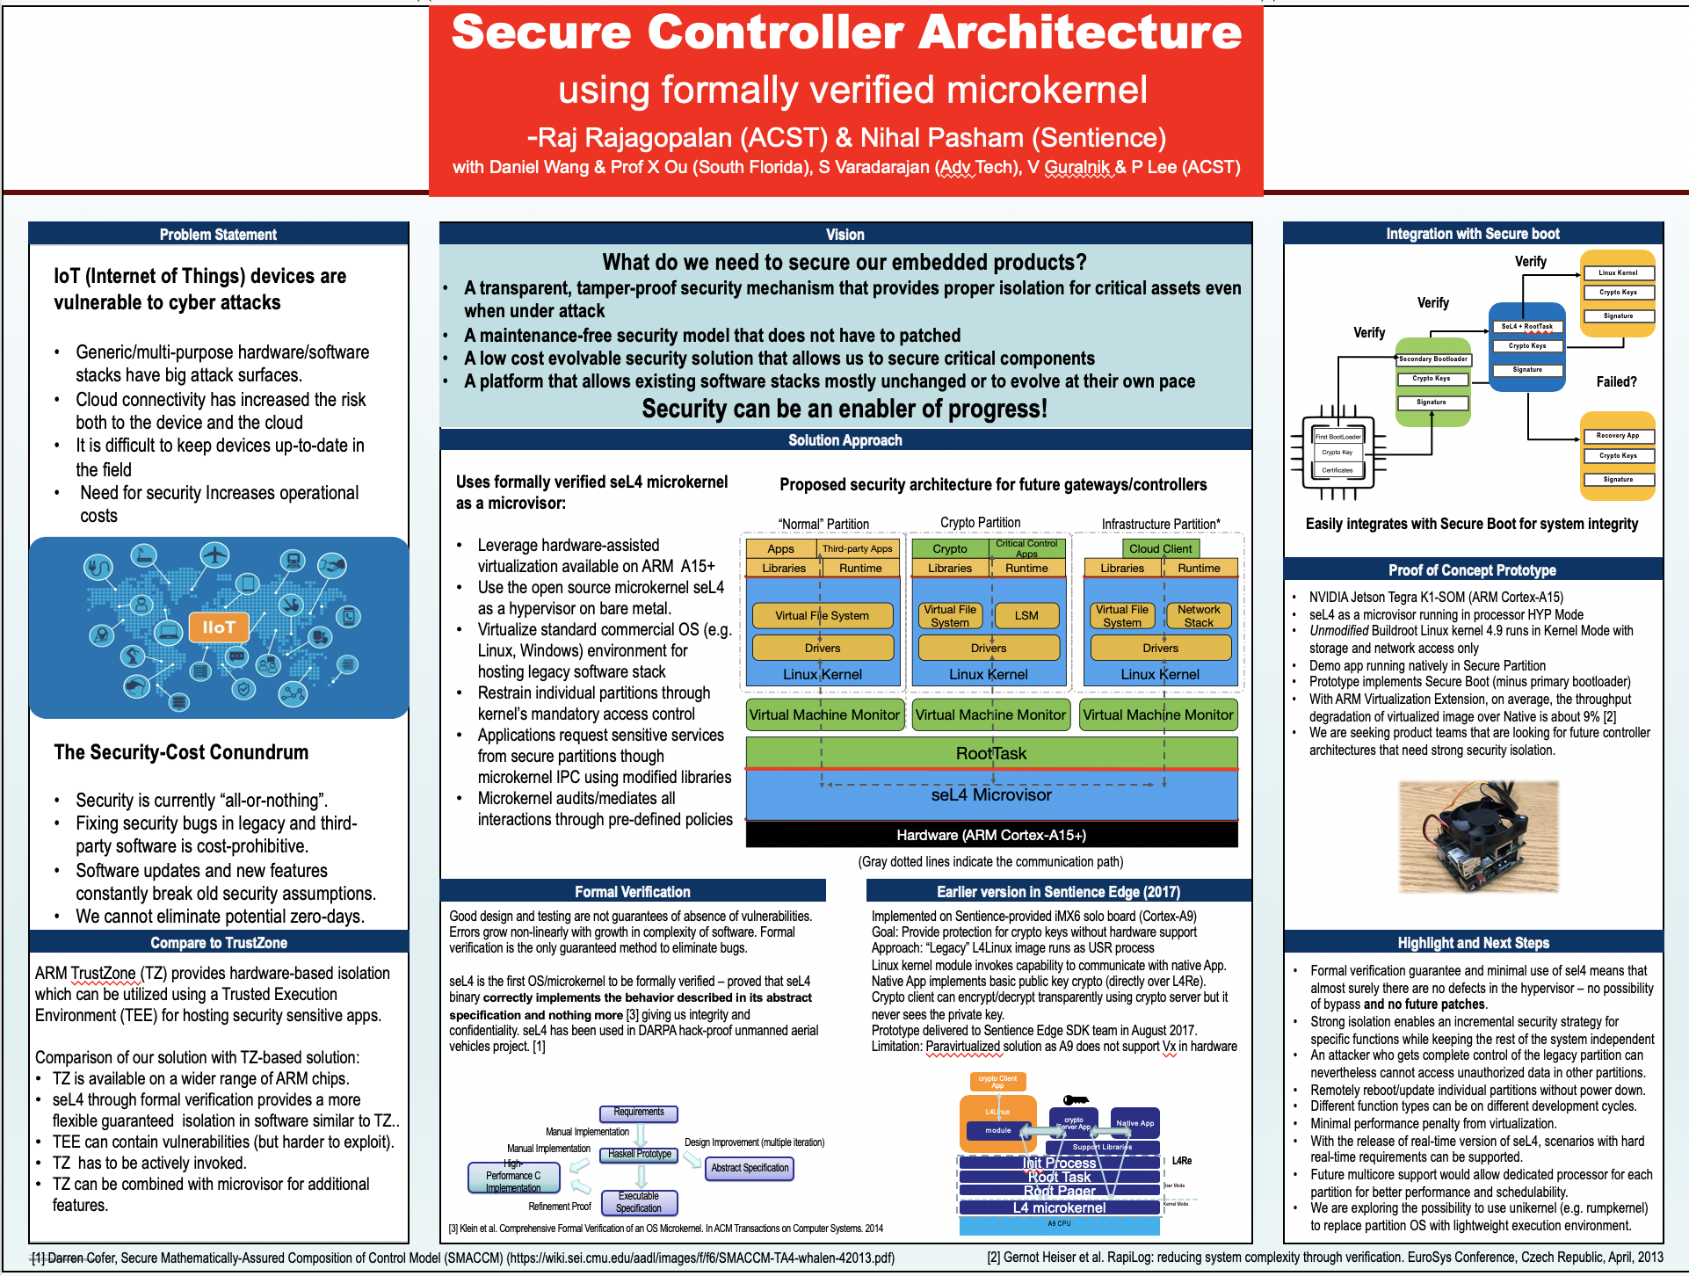

Slide 28
What Happened Afterwards

Slide 29
Project Team Change
Raj left the company in Sept 2018
Daniel graduated in Nov 2018
New PI was appointed at the company
Microsoft Azure-Sphere was rolled out in late 2018

Slide 30
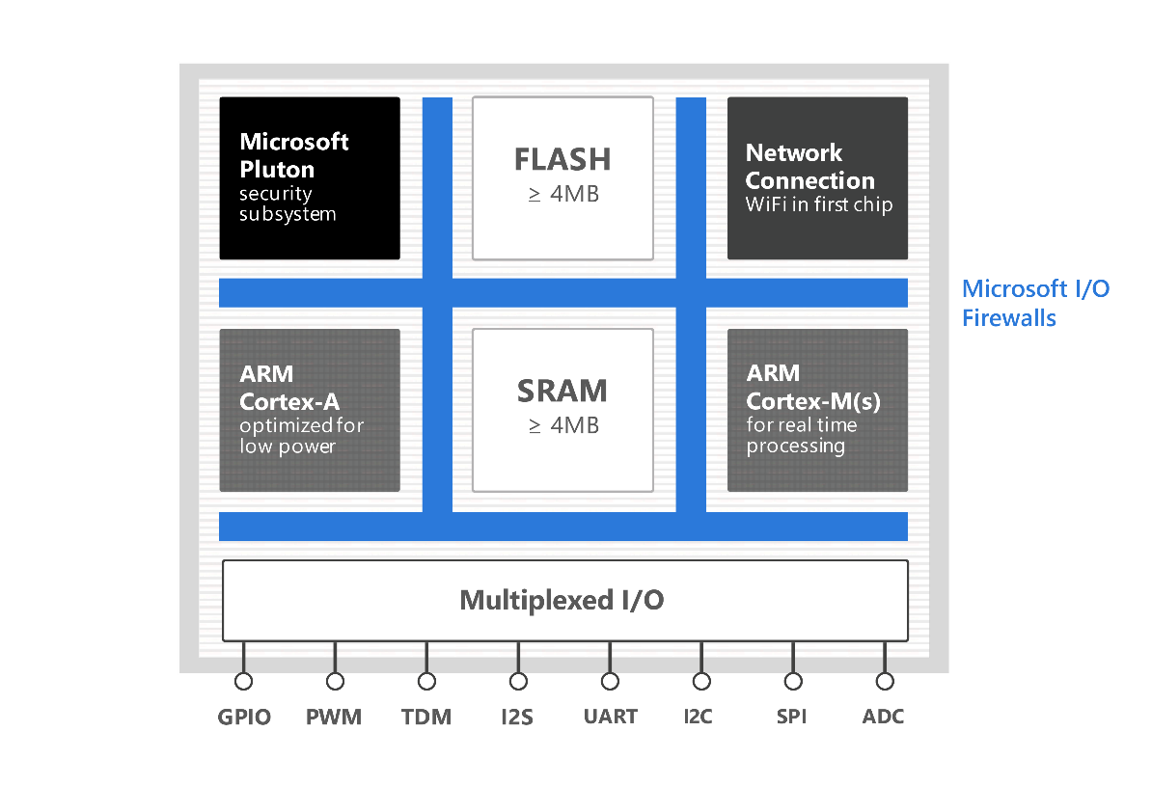
Azure Sphere Hardware Architecture
End-to-end solution for secure microcontrollers
CPU cores isolated by hardware
Microsoft Pluto provides hardware root of trust (TPM like module)
Customized Linux sandboxes applications (Android-like middleware)

Slide 31
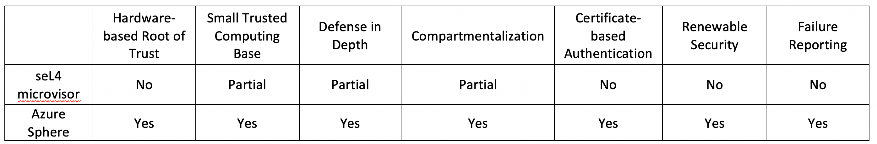

Asked New Company Team to Provide a Comparison between Our seL4-based Solution and Azure Sphere
Totally Wrong Comparison
But Very Good Marketing
Comparison based on G. Hunt, G. Letey and E. Nightingale, "The Seven Properties of Highly Secure Devices," Microsoft Research NExT Operating Systems Technologies Group, 2018.
Conclusion: Azure Sphere wins out!

Slide 32
What Lessons can We Learn?
How do we communicate the value of seL4 to business stake holders?
Tech transition requires a champion inside the company.
Is the seL4 community interested in adoption by the commercial world?

Slide 33
Some showstoppers
Microcontroller
  Typical CPUs used in these systems do not have a MMU
  This is becoming less of a problem,
  Sel4 does NOT run on most CPUs of interest
Accessories
  Typical devices that must be supported need device drivers
  Embedded systems have atypical set of accessory devices.
Firmware
  If firmware can be corrupted how do we protect the secure kernel?
  Do we move the kernel into firmware?
Operating System
  Most systems use off-the-shelf OS for maintenance and interoperability
  What place does a secure microkernel have?

Slide 34
How to make progress
Progress is incremental
The problem is not technological
Businesses rarely rely on single technologies but on a progression
Progressions imply long-term relationships
Most businesses are merely middlemen in a long value chain
How do we place ourselves in this chain?

Slide 35
Value Options
Get key chip manufacturers to implement sel4
Incorporate sel4 in secure boot
Get Key OS sources to incorporate sel4
Provide a direct mechanism for applications to directly leverage sel4
Create documentation and other self-help tools for developers to become comfortable with using sel4
Encourage the user community to play and experiment with sel4

Slide 36
Takeaway
To make seL4 work for the commercial world, perhaps the community needs to engage the relevant stake holders regularly
  They worry about very different things
seL4 only addresses the security of a very small part of the overall system
  However its adoption imposes substantial constraints on the rest of the system (at least for the foreseeable future).
  How can the community justify the value-add to the stake holders?

