Slide 1
The Airplane
Chapter 7
Flight Instruments

Slide 2
Figure 7-1. The flight instruments.

Slide 3
Figure 7-2. Static pressure.

Slide 4
Figure 7-3. Dynamic pressure depends on air density.

Slide 5
Figure 7-4. Static vent.

Slide 6
Figure 7-5. Pitot head.

Slide 7
Figure 7-6. Typical pitot-static installation.

Slide 8
Figure 7-7. The pitot-static system.

Slide 9
Figure 7-8. The airspeed indicator measures dynamic pressure.

Slide 10
Figure 7-9. ASI coding.

Slide 11
Figure 7-10. The airspeed indicator.

Slide 12
Figure 7-11. With IAS constant, TAS increases with increase in altitude.

Slide 13
Figure 7-12. Altimeter.

Slide 14
Figure 7-13. The altimeter is a pressure-sensitive instrument.

Slide 15
Figure 7-14. The altimeter measures height above the pressure level set in the pressure window.

Slide 16
Figure 7-15. Altimeter presentation.

Slide 17
Figure 7-16. On the ground, the altimeter should read airport elevation.

Slide 18
Figure 7-17. Always update your altimeter setting.

Slide 19
Figure 7-18. A blocked static vent—altimeter indication constant regardless of airplane altitude.

Slide 20
Figure 7-19. Temperature error often causes indicated altitude to differ from true altitude.

Slide 21
Figure 7-20. VSI.

Slide 22
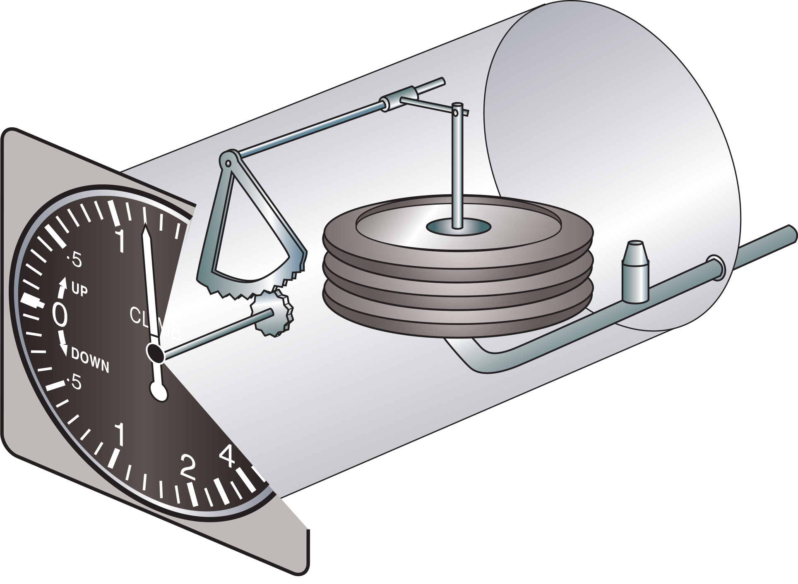
Figure 7-21. The vertical speed indicator.

Slide 23
Figure 7-22. Gyroscopes are rotating masses.

Slide 24
Figure 7-23. Gyroscopic precession.

Slide 25
Figure 7-24. Suction (vacuum) gauge.

Slide 26
Figure 7-25. Turn coordinator.

Slide 27
Figure 7-26. The modern turn coordinator (left), and the older turn indicator, each indicating standard-rate turns to the left.

Slide 28
Figure 7-27. Workings of the turn indicator.

Slide 29
Figure 7-28. Attitude indicator.

Slide 30
Figure 7-29. The attitude indicator displays pitch attitude and bank angle.

Slide 31
Figure 7-30. Pitch attitude displayed on the AI does not reflect climb/descent performance.

Slide 32
Figure 7-31. The heading indicator.

Slide 33
Figure 7-32. The coordination ball.

Slide 34
Figure 7-33. The coordination ball.

Slide 35
Figure 7-34. Slipping turn; more right rudder required (left). A comfortable and coordinated turn (center). A skidding turn (right).

Slide 36
Figure 7-35. Critical angle of attack, stall, and angle of attack indicators.

Slide 37
Figure 7-36. Magnetic compass.

Slide 38
Figure 7-37. The earth has a magnetic field.

Slide 39
Figure 7-38. Direction.

Slide 40
Figure 7-39. A simple bar magnet.

Slide 41
Figure 7-40. Variation is the angle between true and magnetic; isogonic lines join places of equal magnetic variation.

Slide 42
Figure 7-41. Deviation card.

Slide 43
Figure 7-42. Keep foreign objects away from the magnetic compass.

Slide 44
Figure 7-43. The magnetic compass.

Slide 45
Figure 7-44. Always cross-check compass direction.

Slide 46
Figure 7-45. Magnetic dip is strongest nearest the poles.

Slide 47
Figure 7-46. Dip is caused by the vertical component of the earth’s magnetic field.

Slide 48
Figure 7-47. Magnet suspension.

Slide 49
Figure 7-48. Airspeed indicator.

Slide 50
Figure 7-49. Altimeter presentation.

