Slide 1
Correct-by-Construction Network Stack Synthesis for seL4
Eric Smith
Kestrel Institute and Kestrel Technology
seL4 Summit, September 23-26, 2019, Herndon, VA

Slide 2
Software Synthesis: Another Way to Obtain Formally Verified Code
Kestrel's approach:
Derive code from a specification
Step-by-step, via refinements, often performed by automated transformations
Last step generates code
Each step produces a proof
Chain together all proofs to obtain a proof that the code implements the spec.
derivation

Slide 3
The Spec
Formalizes the requirements and assumptions.
Is written in logic.
Should be as clear and simple as possible.
Should describe what the program should do but not how to do it.
Avoid specifying algorithms or internal data structures
Don't include optimizations!
Best of both worlds:
simple spec
performant code
proofs linking the two

Slide 4
The Derivation
Derivation = a sequence of refinements
Each refinement:
makes a single design choice.
may narrow down the space of possible implementations.
may be carried out by an automated transformation.
can be selected from a library of refinements.
is checked by the theorem prover.
Advantages:
Assurance (correct-by-construction)
Automation
Small, tractable proof steps
Many steps and proofs done by the transformations
Can re-derive implementations after the spec changes
derivation

Slide 5
Kestrel's APT Toolkit for Correct-by-Construction Synthesis
APT = “Automated Program Transformations”
Kestrel’s next-generation software synthesis system
Built on the ACL2 theorem prover
Each synthesis step produces a proof checked by the prover

Slide 6
ACL2: Industrial Strength Prover
APT is based on ACL2, an existing, industrial-strength theorem prover used by many companies
Working with the main ACL2 developer at UT-Austin.

Slide 7
APT Transformations – All Proof-Producing
make-tail-rec
assoc
monoid
nats counting down
bit vectors counting down
list builder (list-to-array)
finite-difference
remove-cdring
expand-lets
letify
simplify-body
simplify
function
second-order function
quantified function
rewrite-body
drop-function-from-nest
drop-irrelevant-params
flatten-params
homogenize-tail-rec
flip-if
rename-params
reorder-params
restructure-elseif
make-do-while
lift-condition
weaken
strengthen
wrap-output
wrap-input
undo-finite-difference
undo-make-tail-rec
define-op
copy-spec
spec substitution
decrease-and-conquer
divide-and-conquer
predicate narrowing
isomorphic data transformation
extract output
restore multiple values
reverse-array-filler
replace-term
apply-rule
last-element-of-list
hoist-if

Slide 8
Examples of Code with Proven Derivations*
MAVLink CRC checksum
MAVLink message creation
MAVLink message parsing
HTTP message creation
HTTP message parsing
AES cipher
TEA cipher
RC6 cipher
Bresenham’s Algorithm
Bitcoin:
Base58 encoding/decoding,
SHA-256, RIPEMD-160
Bitcoin address-to-public-key
factorial
Fibonacci
sum of squares
insertion sort
membership
find index
max element
negate bytes
prime sieve
reverse array
Flex theorem prover / planner
Drone fleet planning
TCP / IP packet parsing
*many of these start by lifting code into logic and use bottom-up steps as well as top-down steps ("analysis by synthesis")

Slide 9
Application to seL4
The seL4 kernel has a very high level of assurance
But: It does not provide the typical POSIX interface that users expect of an operating system (files, processes, networking, etc.).
Implementations exist but many are not yet formally verified
Adding such features to seL4, and extending its assurance case to include them, would go a long way toward increasing its use in critical systems.

Slide 10
Verified Network Stack Synthesis for seL4
We plan to apply our APT toolkit to produce high-assurance, correct-by-construction components for seL4, starting with a TCP/IP stack
A TCP/IP stack:
Is needed by many applications
Faces the external world and thus must safely process data from possible attackers
May be used by multiple seL4 partitions and thus must keep their data strictly separate
We plan to generate C code
We plan to make it open source
The verified TCP/IP stack will help extend seL4's assurance case to larger systems based on seL4

Slide 11
Challenges
Packet parsing and serialization
The TCP state-machine
Buffer management
Sequence numbers and re-transmitting lost packets
Flow control
Congestion control
C code generation
Approach: Start with a minimal feature set and add features over time

Slide 12
Demo: TCP and IP packet parsing
Goal: Synthesize efficient code to parse TCP packet headers.
Start with a spec that is as clear and convenient as possible
Obtain performant code, idiomatic code
The "distance" between spec and code is spanned by proofs
Don't worry about performance in the spec – you will refine to performant code
Don't worry about correctness of the code – it is derived from the spec with proofs
Caveats:
Not yet parsing TCP/IP options
Not yet generating imperative code (APT's C and Java code generators are in progress)

Slide 13
How to Specify TCP Parsing
The problem: Given a sequence of bytes, parse it as a TCP header.
Notes:
Some fields span multiple bytes – have to combine
Some fields are smaller than one byte – have to apply a mask

Slide 14
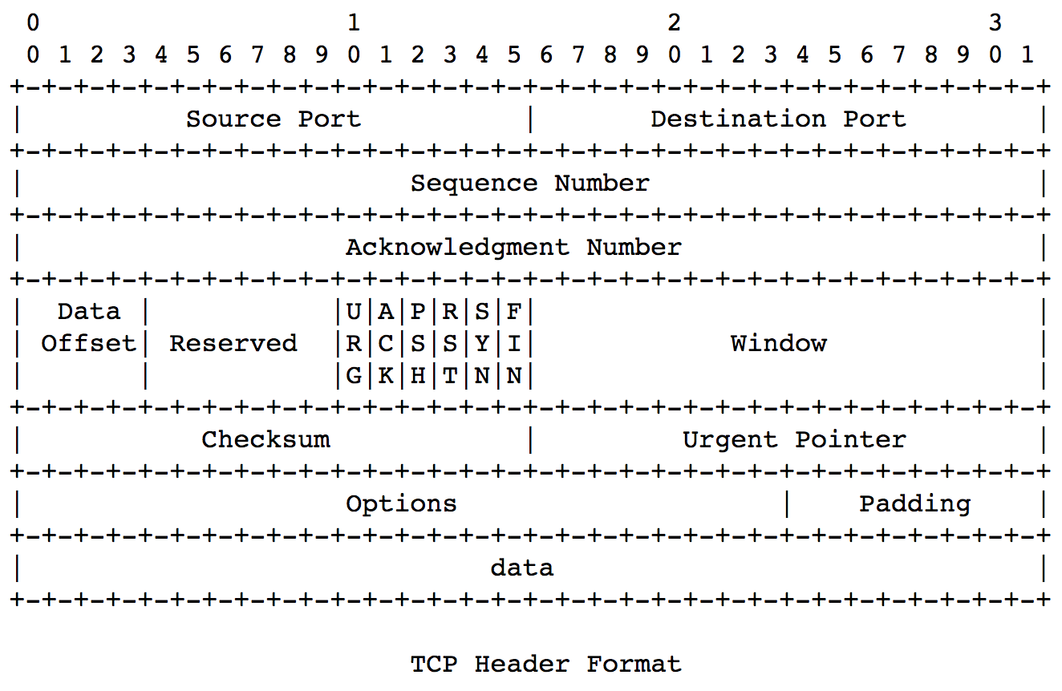
The spec for TCP parsing
Our approach:
Specify the packet layout declaratively.
(defconst *tcp-desc*
'((:source-port 16)
(:destination-port 16)
(:sequence-number 32)
(:ack-number 32)
(:data-offset 4)
(:reserved 4)
(:cwr 1) ; added in RFC3168
(:ece 1) ; added in RFC3168
(:urg 1)
(:ack 1)
(:psh 1)
(:rst 1)
(:syn 1)
(:fin 1)
(:window-size 16)
(:checksum 16)
(:urgent-pointer 16)))

Slide 15
The spec for TCP parsing
Our approach:
Specify the packet layout declaratively.
And specify how to parse any packet, given its layout.
(defconst *tcp-desc*
'((:source-port 16)
(:destination-port 16)
(:sequence-number 32)
(:ack-number 32)
(:data-offset 4)
(:reserved 4)
(:cwr 1)
(:ece 1)
(:urg 1)
(:ack 1)
(:psh 1)
(:rst 1)
(:syn 1)
(:fin 1)
(:window-size 16)
(:checksum 16)
(:urgent-pointer 16)))
(defun parse-bits (desc bits)
(if (endp desc)
nil
(let* ((pair (first desc))
(name (first pair))
(size (second pair)))
(if (< (len bits) size)
:error
(let* ((bits-for-name (take size bits))
(val-for-name (packbv size 1 bits-for-name)))
(acons name
val-for-name
(parse-bits (rest desc) (nthcdr size bits))))))))
(defun parse-bytes (desc bytes)
(parse-bits desc (bytes-to-bits bytes)))

Slide 16
The spec for TCP parsing
(defun parse-tcp (bytes)
(parse-bytes *tcp-desc* bytes))
We could just run this function, but
It is inefficient (converts all the bytes to bits first, then reassembles chunks)
It uses operators that are not available in most languages (packbv, bvcat)
It uses data structures that are undesirable in the implementation (lists).
We want an equivalent version that grabs the appropriate bits for each field and applies low-level operators to shift, mask, and concat.
We will create a derivation to transform the spec into efficient code.

Slide 17
The derivation for TCP parsing
3 steps:
Partial evaluation: Specialize parse-bytes to the concrete descriptor for TCP.
Expand/unroll various functions, including bytes-to-bits, parse-bits, and packbv.
Apply many simplification rules from our library (e.g., combine adjacent bits of a byte into a slice).
The result avoids creating the list of bits.
Apply bit-vector simplification rules to produce idiomatic code
Replace getbit with a mask and a shift.
Replace slice with a mask and a shift.
Replace bvcat with a shift and an OR.
Extend BV ops to operate in 32-bit fields.
Introduce lets for common subexpressions.

Slide 18
TCP Derivation Step 1
(def parse-tcp.1
(simplify parse-tcp
:assumptions ((all-unsigned-byte-p 8 bytes)
(equal (len bytes) 20))
:enable (packbv-opener car-becomes-nth-of-0 3-cdrs
bytes-to-bits-unroll byte-to-bits consp-of-cdr)
:untranslate t))

Slide 19
TCP Derivation: Result of Step 1
(DEFUN PARSE-TCP.1 (BYTES)
(LIST (CONS :SOURCE-PORT (BVCAT 8 (NTH 0 BYTES) 8 (NTH 1 BYTES)))
(CONS :DESTINATION-PORT (BVCAT 8 (NTH 2 BYTES) 8 (NTH 3 BYTES)))
(CONS :SEQUENCE-NUMBER (BVCAT 8 (NTH 4 BYTES)
24 (BVCAT 8 (NTH 5 BYTES)
16 (BVCAT 8 (NTH 6 BYTES) 8 (NTH 7 BYTES)))))
(CONS :ACK-NUMBER (BVCAT 8 (NTH 8 BYTES)
24 (BVCAT 8 (NTH 9 BYTES)
16 (BVCAT 8 (NTH 10 BYTES) 8 (NTH 11 BYTES)))))
(CONS :DATA-OFFSET (SLICE 7 4 (NTH 12 BYTES)))
(CONS :RESERVED (BVCHOP 4 (NTH 12 BYTES)))
(CONS :CWR (GETBIT 7 (NTH 13 BYTES)))
(CONS :ECE (GETBIT 6 (NTH 13 BYTES)))
(CONS :URG (GETBIT 5 (NTH 13 BYTES)))
(CONS :ACK (GETBIT 4 (NTH 13 BYTES)))
(CONS :PSH (GETBIT 3 (NTH 13 BYTES)))
(CONS :RST (GETBIT 2 (NTH 13 BYTES)))
(CONS :SYN (GETBIT 1 (NTH 13 BYTES)))
(CONS :FIN (GETBIT 0 (NTH 13 BYTES)))
(CONS :WINDOW-SIZE (BVCAT 8 (NTH 14 BYTES) 8 (NTH 15 BYTES)))
(CONS :CHECKSUM (BVCAT 8 (NTH 16 BYTES) 8 (NTH 17 BYTES)))
(CONS :URGENT-POINTER (BVCAT 8 (NTH 18 BYTES) 8 (NTH 19 BYTES)))))

Slide 20
Library Rules Used in Step 1
(:DEFINITION ACONS)
(:DEFINITION ATOM)
(:DEFINITION BYTE-TO-BITS)
(:DEFINITION PARSE-BITS)
(:DEFINITION PARSE-BYTES)
(:DEFINITION SYNP)
(:REWRITE 3-CDRS)
(:REWRITE APPEND-OF-CONS)
(:REWRITE APPEND-OF-NIL)
(:REWRITE APPEND-WHEN-NOT-CONSP)
(:REWRITE BVCAT-OF-BVCHOP-HIGH)
(:REWRITE BVCAT-OF-BVCHOP-LOW)
(:REWRITE BVCAT-OF-GETBIT-AND-GETBIT-ADJACENT)
(:REWRITE BVCAT-OF-GETBIT-AND-SLICE-ADJACENT)
(:REWRITE BVCAT-OF-GETBIT-AND-X-ADJACENT)
(:REWRITE BVCAT-OF-GETBIT-AND-X-ADJACENT-2)
(:REWRITE BVCAT-OF-GETBIT-ARG2)
(:REWRITE BVCHOP-IDENTITY)
(:REWRITE BVCHOP-OF-GETBIT)
(:REWRITE BYTES-TO-BITS-BASE)
(:REWRITE BYTES-TO-BITS-UNROLL)
(:REWRITE CAR-BECOMES-NTH-OF-0)
(:REWRITE CAR-OF-NTHCDR)
(:REWRITE CDR-CONS)
(:REWRITE CONSP-FROM-LEN-CHEAP)
(:REWRITE CONSP-OF-CDR)
(:REWRITE LEN-OF-CDR)
(:REWRITE LEN-OF-CONS)
(:REWRITE LEN-OF-NTHCDR)
(:REWRITE LIST-FIX-WHEN-TRUE-LISTP)
(:REWRITE NTH-OF-CDR)
(:REWRITE NTH-OF-CONS-CONSTANT-VERSION)
(:REWRITE NTH-OF-NTHCDR)
(:REWRITE NTHCDR-OF-1)
(:REWRITE NTHCDR-OF-CONS)
(:REWRITE NTHCDR-OF-NTHCDR)
(:REWRITE PACKBV-OF-1)
(:REWRITE PACKBV-OPENER)
(:REWRITE SLICE-BECOMES-BVCHOP)
(:REWRITE TAKE-OF-1)
(:REWRITE TAKE-OF-CONS)
(:REWRITE TAKE-OF-TOO-MANY)
(:REWRITE UNSIGNED-BYTE-P-OF-NTH)

Slide 21
Examples of Library Rules Used
(DEFTHM BYTES-TO-BITS-UNROLL
(IMPLIES (NOT (ATOM BYTES))
(EQUAL (BYTES-TO-BITS BYTES)
(APPEND (BYTE-TO-BITS (CAR BYTES))
(BYTES-TO-BITS (CDR BYTES))))))
(DEFTHM PACKBV-OPENER
(IMPLIES (NOT (ZP ITEMCOUNT))
(EQUAL (PACKBV ITEMCOUNT ITEMSIZE ITEMS)
(BVCAT ITEMSIZE
(CAR ITEMS)
(* ITEMSIZE (+ -1 ITEMCOUNT))
(PACKBV (+ -1 ITEMCOUNT) ITEMSIZE (CDR ITEMS))))))
(DEFTHM BVCAT-OF-GETBIT-AND-GETBIT-ADJACENT
(IMPLIES (AND (EQUAL N (+ 1 M))
(NATP M))
(EQUAL (BVCAT 1 (GETBIT N X) 1 (GETBIT M X))
(SLICE N M X))))

Slide 22
TCP Derivation Step 2
;; Replace getbit and slice with shifting and masking, replace bvcat with
;; shifting and ORing, extend BV operations to 32 bits
(def parse-tcp.2
(simplify parse-tcp.1
:assumptions ((all-unsigned-byte-p 8 bytes)
(equal (len bytes) 20))
:enable (getbit-as-mask-and-shift
slice-as-mask-and-shift
bvchop-becomes-bvand32-with-mask
bvcat-becomes-bvor-of-shl
shr-extend-to-32bits
shl-extend-to-32bits
bvand-extend-to-32bits
bvor-extend-to-32bits)))

Slide 23
TCP Derivation Step 3
;; Introduce lets:
(def parse-tcp.3
(letify parse-tcp.2))

Slide 24
TCP Derivation: Final Result
(DEFUN PARSE-TCP.3 (BYTES)
(LIST*
(CONS :SOURCE-PORT (BVOR 32 (NTH 1 BYTES) (SHL 32 (NTH 0 BYTES) 8)))
(CONS :DESTINATION-PORT (BVOR 32 (NTH 3 BYTES) (SHL 32 (NTH 2 BYTES) 8)))
(CONS :SEQUENCE-NUMBER (BVOR 32 (SHL 32 (NTH 4 BYTES) 24)
(BVOR 32 (SHL 32 (NTH 5 BYTES) 16)
(BVOR 32 (NTH 7 BYTES)
(SHL 32 (NTH 6 BYTES) 8)))))
(CONS :ACK-NUMBER (BVOR 32 (SHL 32 (NTH 8 BYTES) 24)
(BVOR 32 (SHL 32 (NTH 9 BYTES) 16)
(BVOR 32 (NTH 11 BYTES)
(SHL 32 (NTH 10 BYTES) 8)))))
(LET
((X (NTH 12 BYTES)))
(LIST*
(CONS :DATA-OFFSET (SHR 32 (BVAND 32 240 X) 4))
(CONS :RESERVED (BVAND 32 15 X))
(LET
((X1 (NTH 13 BYTES)))
(LIST
(CONS :CWR (SHR 32 (BVAND 32 128 X1) 7))
(CONS :ECE (SHR 32 (BVAND 32 64 X1) 6))
(CONS :URG (SHR 32 (BVAND 32 32 X1) 5))
(CONS :ACK (SHR 32 (BVAND 32 16 X1) 4))
(CONS :PSH (SHR 32 (BVAND 32 8 X1) 3))
(CONS :RST (SHR 32 (BVAND 32 4 X1) 2))
(CONS :SYN (SHR 32 (BVAND 32 2 X1) 1))
(CONS :FIN (BVAND 32 1 X1))
(CONS :WINDOW-SIZE (BVOR 32 (NTH 15 BYTES) (SHL 32 (NTH 14 BYTES) 8)))
(CONS :CHECKSUM (BVOR 32 (NTH 17 BYTES) (SHL 32 (NTH 16 BYTES) 8)))
(CONS :URGENT-POINTER (BVOR 32 (NTH 19 BYTES) (SHL 32 (NTH 18 BYTES) 8)))))))))

Slide 25
Final theorem
;; Proved by chaining the theorems from the 3 steps
(defthm parse-tcp.3-correct
(implies (and (all-unsigned-byte-p 8 bytes)
(equal (len bytes) 20))
(equal (parse-tcp bytes)
(parse-tcp.3 bytes)))
:hints (("Goal" :in-theory (disable parse-tcp
parse-tcp.3))))

Slide 26
Reusability
Big Question: How brittle / fragile is the derivation?
If the packet layout changes, how much work to adapt the derivation?
Answer: Not much
Our spec for IP packet parsing:
Uses the same parse-bytes function as the spec for TCP
Only differs in the concrete descriptor
Our derivation of IP packet parsing:
Uses the same 3 derivation steps as for TCP
Historical note: IP required small changes to handle multi-byte fields that include a partial byte (not present in TCP). The resulting derivation works for both TCP and IP.

Slide 27
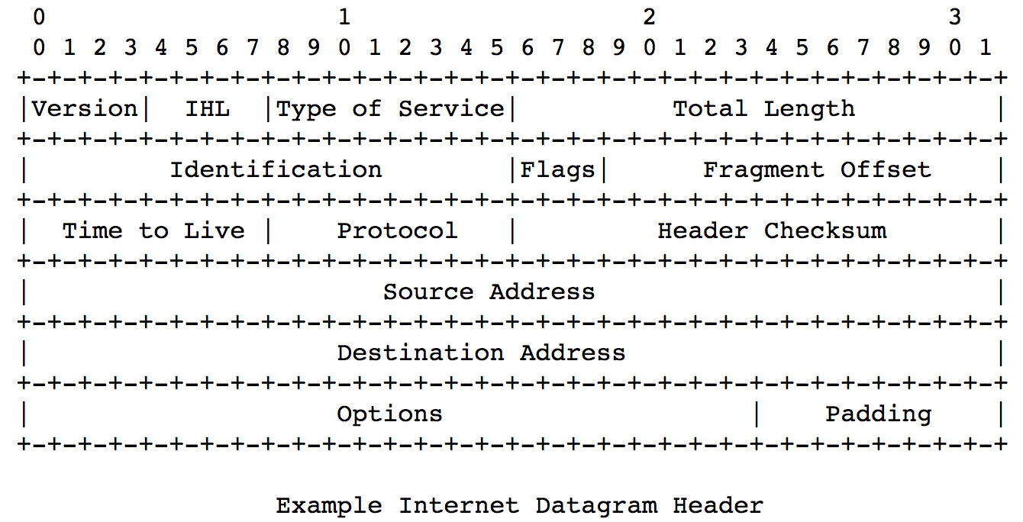
IP packet parsing
(defconst *ip-desc*
'((:version 4)
(:ihl 4)
(:dscp 6) ;;since RFC2474
(:ecn 2) ;;since RFC3168
(:total-length 16)
(:identification 16)
(:flags 3)
(:fragment-offset 13)
(:time-to-live 8)
(:protocol 8)
(:header-checksum 16)
(:source-ip 32)
(:destination-ip 32)))

Slide 28
IP packet parsing
Spec just passes the descriptor to parse-bytes:
(defun parse-ip (bytes)
(parse-bytes *ip-desc* bytes))
Derivation has the same 3 steps
Result is performant and idiomatic
Analogous final theorem proved:
(DEFTHM PARSE-IP.3-CORRECT
(IMPLIES (AND (ALL-UNSIGNED-BYTE-P 8 BYTES)
(EQUAL (LEN BYTES) 20))
(EQUAL (PARSE-IP BYTES)
(PARSE-IP.3 BYTES))))

Slide 29
Generated code for IP
(DEFUN PARSE-IP.3 (BYTES)
(LET ((X (NTH 0 BYTES)))
(LIST* (CONS :VERSION (SHR 32 (BVAND 32 240 X) 4))
(CONS :IHL (BVAND 32 15 X))
(LET ((X1 (NTH 1 BYTES)))
(LIST* (CONS :DSCP (SHR 32 (BVAND 32 252 X1) 2))
(CONS :ECN (BVAND 32 3 X1))
(CONS :TOTAL-LENGTH (BVOR 32 (NTH 3 BYTES) (SHL 32 (NTH 2 BYTES) 8)))
(CONS :IDENTIFICATION (BVOR 32 (NTH 5 BYTES) (SHL 32 (NTH 4 BYTES) 8)))
(LET
((X2 (NTH 6 BYTES)))
(LIST
(CONS :FLAGS (SHR 32 (BVAND 32 224 X2) 5))
(CONS :FRAGMENT-OFFSET (BVOR 32 (NTH 7 BYTES) (SHL 32 (BVAND 32 31 X2) 8)))
(CONS :TIME-TO-LIVE (NTH 8 BYTES))
(CONS :PROTOCOL (NTH 9 BYTES))
(CONS :HEADER-CHECKSUM (BVOR 32 (NTH 11 BYTES) (SHL 32 (NTH 10 BYTES) 8)))
(CONS :SOURCE-IP (BVOR 32 (SHL 32 (NTH 12 BYTES) 24) (BVOR 32 (SHL 32 (NTH 13 BYTES) 16) (BVOR 32 (NTH 15 BYTES) (SHL 32 (NTH 14 BYTES) 8)))))
(CONS :DESTINATION-IP (BVOR 32 (SHL 32 (NTH 16 BYTES) 24) (BVOR 32 (SHL 32 (NTH 17 BYTES) 16) (BVOR 32 (NTH 19 BYTES) (SHL 32 (NTH 18 BYTES) 8))))))))))))

Slide 30
Project Status
Phase 1 (feasibility study) complete
Initial experiments worked out
Starting Phase 2 soon
Thanks to DARPA and the Army Combat Capabilities Development Command, Ground Vehicle Systems Center (GVSC)

Slide 31
Possible Future Directions
In addition to a TCP/IP stack, we are interested in synthesizing high-assurance
application-level protocols (HTTP, TLS)
applications (webservers)
device drivers
etc.

